Slide 1
CS 211 Project
IoT Platform (Device-to-device communication)
By Akshay Joshi
Mentor: Yunqi Guo

Slide 2
Outline
Introduction
Components and flow
Key aspects
Demonstration and results
Roadblocks
Future work
Summary and insights

Slide 3
What is IoT?
Secure connection of billions of ‘things’
These devices, or things, connect to the network to:
Provide information they gather from the environment through sensors.
Allow other systems to reach out and act on the world through actuators.
Examples:
Wide range (Autonomous machinery in industrial sector to fitness tracker on the wrist)
Smart Home

Slide 4
Project Components and Flow
1. Server starts up
Server
2. Sender connects with and authenticates the server on its IP address and a port
4. Receiver connects with and authenticates the server on its IP address and a port
4. Server checks if the receiver is connected or not.
3. Sender sends the message to the server
5. If it is connected, the server sends the message to the receiver device
Sender
Device
Receiver
Device

Slide 5
Key Considerations
Authentication
Sender device as well as the receiver device must be able to authenticate the server’s identity. (Use of certificates)
Acknowledgements
Sender device must have full transparency of the operations being carried out like the status of transmission, reception, failure. (Use of acknowledgements)
Elimination of dependencies
Sender device’s operation should be independent of the connectivity of the receiver device. (Use of buffer and a timer at the server side)

Slide 6
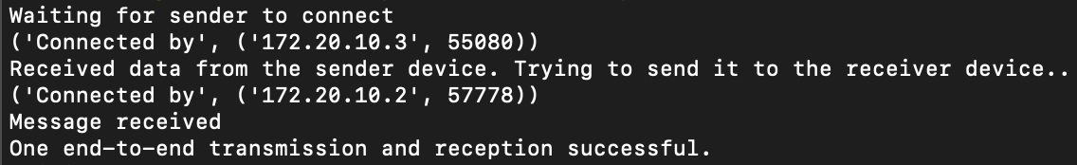
Demonstration and Results
Server side:

Slide 7
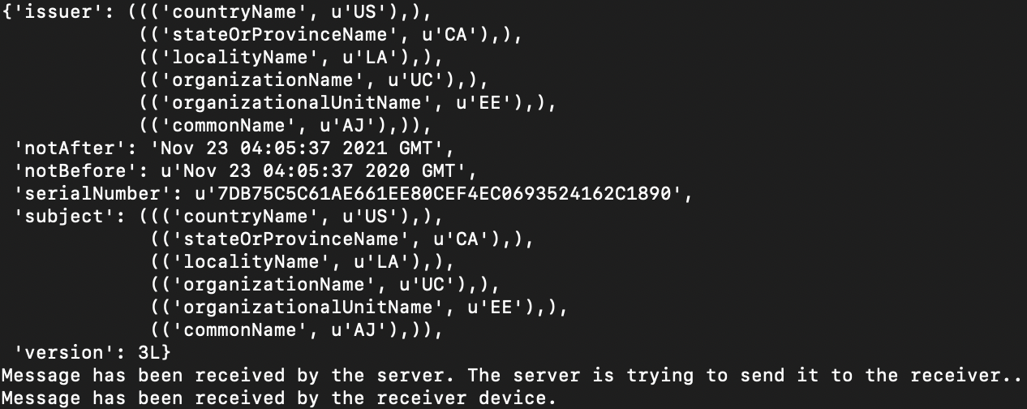
Demonstration and Results
Sender device:

Slide 8
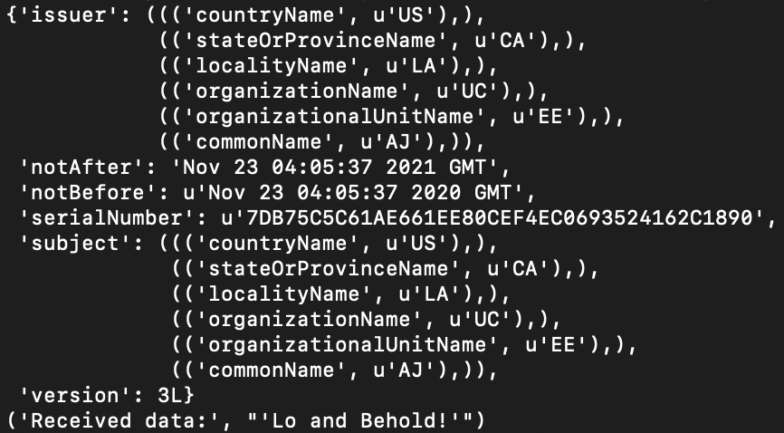
Demonstration and Results
Receiver device:

Slide 9
Demonstration and Results
What if the receiver device is not connected?
Need to move this complexity to the server side to keep end devices simple.
Solution: Employing timer.
Server receives data irrespective of receiver connectivity.
Starts timer and waits for a period of time for the receiver to connect.
Sends negative acknowledgement if the timer runs out

Slide 10
Roadblocks
Mapping and consideration of key features
Authentication
Not much on the internet about the usage of certificates
Needed to create self-signed certificates
Elimination of dependencies
Difficult to chalk out the flow of information
Needed to eliminate dependencies
Move complexity to server side to make end devices simple (Principle learnt from lecture slides)

Slide 11
Future Work
Two-way/mutual authentication:
The current work can be upgraded to include authentication at the devices’ sides as well to add another layer of security/authentication
Encryption:
This current build of the prototype doesn’t support encryption of the message
An attacker can intercept the message midway or even at the server
Public and private keys can be employed to enhance security and to provide end-to-end encryption
Support of more types of files:
This prototype currently supports the transmission of only strings of text
Can extend this to audio/video and image files

Slide 12
Summary and insights
A good IoT platform should have following features among many more:
Protocol Support
Scalability
Security
Data integration and analytics
Out of the above 4, scalability and security have been looked at and explored. One can extend this prototype to include multiple devices and components and scale the system as per need.
Also, security forms one of the most important aspect which is often overlooked. This project aimed to elevate the importance of security in a general purpose IoT setting.

